Slide 1



Writing a Class (Animating Multiple Objects)
Developing a Class

Slide 2
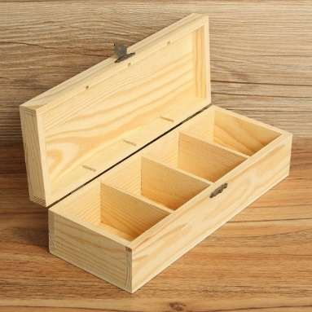
Learning Objectives
Last Weeks
Class – template for an object, description of members (variables) and methods (functions and procedures)
Object – Instance of a Class. Variable with compartments - members
Methods – functions (procedures) how to use the class
Constructor – special method called on NEW command
Parameters – passing values to methods
This Weeks Objectives
Develop a Class
Animate an object
More methods

Slide 3
Revision : Class motorbike
members : x, y, speed
methods : constructor, move, render
Declare 2 instances of the class
As yet no actual box (memory)
In setup create the memory using new
call the constructor – initialise the object
In draw event we could add move and render for b1 & b2
class motorbike {
int x = 5;
int y;
int speedX;
motorbike(int y, int speed){}
void move() {}
void render() {}
}
motorbike b1,b2;
void setup()
{
b1 = new motorbike(10,2);
b2 = new motorbike(50,3);
}
void draw()
{
background(0);
b1.render();
b1.move();
b2.render();
b2.move();
}
members
methods

Slide 4
Class and objects
class motorbike{
int x = 5;
int y;
int speedX;
motorbike(int y, int speed)
…
}
motorbike b1,b2;
void setup()
{
b1 = new motorbike(10,2);
b2 = new motorbike(50,3);
}
Class:motorbike
x
y
speedX
x
5
null
null
y
10
b1
speedX
2
x
5
null
null
y
50
b2
speedX
3

Slide 5

Problem : flying birds
What information to animate a bird flying around screen?
Easy
x, y, speedX, speedY
Harder
Picture, changing picture in a sequence (image1, image2, image3, image2, image1…)
Top down design
Clear background
Draw current image
Move image right (or another direction)
Cycle Current image through sequence

Slide 6
Adding Images to Class Bird
PImage - Built-in Class to allow us to load and display image files
Has members including: float width, height
Has methods including void resize(width, height);
Can create instances of PImage and load image files into each
PImage image1 = loadImage(“bird1.jpg");
image(image1,x,y); //image command displays image1 at x,y

Slide 7



Bird members
complete it
class Bird
{
int x;
int y;
int speedX, speedY;
PImage image1,image2, image3; //member : instance of a PImage class
}
What methods do we need?

Slide 8
Bird Methods
What should a Bird be able to do?
Moves around screen [up,down,left,right] (cycles through images)
Move
Display (render)
A constructor?
What information to setup a new bird?
Where is it?
How fast : x direction, y direction?

Slide 9



Methods – top down design
image1
Move (easy – same as bouncing ball)
Add speedX to x location
Add speedY to y location
Detect bounces off edges?
Render (top down)
Select next image in sequence
Draw image at x,y
Too fast – changes picture every 60th sec!, messy
image2
image3
Select next image in sequence
If (currentImage is image1)
currentImage is image2
Else if (currentImage is image2)
currentImage is image3
…
Draw currentImage
complete it
What effect – draw repeated 60x sec
Needs to go forward then back thru images
Notes:
complete pseudocode

Slide 10
Cycle through images
image1
image2
Too quick – better to show the same image for n frames
E.g. 10 frames for each image – how?
Introduce a counter
Pseudocode?
Don’t need currentImage
Counter determines where in sequence.
Where would we declare Counter?
What about when image3
image3
Cycle Current image through sequence
If (counter >=0 && counter <=10)
draw image1
Else if (counter >10 && counter <=20)
draw image2
…
Else
countDir= -countDir; //reverse sequence
counter = counter+countDir; //+1 or -1
member : counter
Notes:
counter was a local var, it would reset every time we call render()!
Needs to be a member of the class

Slide 11
Move Method
class Bird {
int x;
int y;
int speedX, speedY;
int counter = 0;
int countDir=1;
PImage image1,image2,image3;
void move()
{
x = x+speedX;
y = y+speedY;
}
void render()
{
if (counter>=0 && counter<=10){
image(image1,x,y);
}
else if (counter>10 && counter<=20){
image(image2,x,y);
}
else if (counter>20 && counter<=25)
{
image(image3,x,y);
}
else
{
countDir = -countDir; //reverse sequence
}
counter = counter + countDir;
}

Slide 12
Bird Constructor
class Bird {
int x;
int y;
int speedX, speedY;
int counter = 0;
int countDir=1;
PImage image1,image2,image3;
Bird (int x, int y, int dx, int dy)
{
this.x = x;
this.y = y;
this.speedX=dx;
this.speedY = dy;
image1 = loadImage("bird1.jpg");
image2 = loadImage("bird2.jpg");
image3 = loadImage("bird3.jpg");
}
What information to setup a new Bird?
Where is it?
How fast – left to right?
Top down – pseudocode
Set x
Set y
Set speed (x axis, y axis)
Load pictures- sequence
Perhaps resize images
( )
load is slow, constructor called only once

Slide 13
Using the class
Bird polly, bluey;
void setup()
{
size(500,500);
polly = new Bird(500,100,-3,2);
bluey= new Bird(500,150,-5,-5);
}
void draw()
{
background(255);
polly.render();
polly.move();
bluey.render();
bluey.move();
}
Let's set up 2 flying birds
Different directions
Top down design (for 1 Bird)
Clear background
Draw current image
Move image right
Cycle Current image through sequence
Refactor?

Slide 14
Refactor
Bird polly, bluey;
void draw()
{
background(255);
polly.update();
bluey.update();
}
Bird always has render then move
Introduce a new method with these steps
void update()
{
render();
move();
}

Slide 15
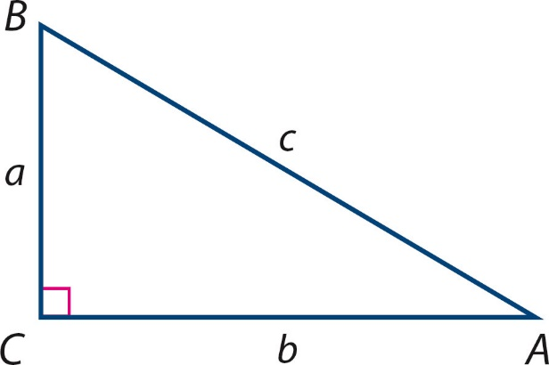
Collision – proximity detection
Collision detection can be handled by measuring the distance between two on-screen objects
Simplified as : if x locations are within a threshold AND y locations are within a threshold then a collision is detected
Let's write a collision method for Bird – detect whether another bird is too close
Method procedure or function method – i.e. return void or ?
(xs,ys)
sqrt((xc-xs)² + (yc-ys) ²)
yc-ys
(xc,yc)
xc-xs

Slide 16
Collision method
Function : True or false – Boolean
If we were detecting collisions with another Bird
What parameters – if any?
Bird
Add to Bird class
boolean crash(Bird other)
{
return (abs(this.x-other.x) < 10 && abs(this.y-other.y) < 10);
}
absolute value, e.g.
abs(-10) = 10
abs(10) = 10
Notes:
could use pythag instead

Slide 17
Summary
Class Created Objects – instances of our Class
Develop a Class for animating objects – moving and changing image
Constructor
More methods –
update
collision detection
Refactoring – improving, simplifying our code

